Slide 1


Excelling at CLINICAL
Escalation

Slide 2
ESCALATION
Excelling at Conversations and Escalations
Helping maternity units to build the right culture and conditions to enable effective clinical escalation and communication

Slide 3
Session Outline
Defining Clinical Escalation
Where are we now?
How might we continue to improve
  Understand how we all do fresh eyes – case exercise
Think about taking the same approach with our conversations? ……. Introduce ‘Teach or Treat’ approach
Reflect on escalation language and documentation
What now – what have you learnt and what will you do now?

Slide 4
Components of Clinical Escalation
Identify
Communicate
Act
Notes:
This is expanded upon in the next slide. Very briefly go through the need to recognise a problem, make sure that the correct person is informed, then an appropriate response or action is obtained

Slide 5
What is escalation?
Identify
Correctly recognise deviation from normality
Communicate
Closed loop structured communication
Act
Appropriate response and speed
Appreciation of risk factors
Flattened MDT hierarchy
Infrastructure – staff / theatres available
Assertive escalation / receptive action
Be aware of when you are escalating
Notes:
3 basic steps and preconditions that have to happen in effective clinical escalation:
Identify – that there is a clinical problem/deterioration
Communicate – escalation the concern
Act – get the appropriate response in the right time
Anything else?
Intrinsic factors – confidence, motivation, competence
Extrinisic factors
Environment etc

Slide 6

Where are we now?
How can we continue to improve?
Where are we now?
  National learning – Each Baby Counts 2019 identified the following:
    59% of cases - CTG and FBS contributed to poor outcomes
    13% - equipment problems identified
    33% - interpretation errors
    44% - failure to act on suspicious or pathological CTG
    3% - FBS errors
  Local learning – HSIB reviews
How can we continue to improve? – the million $ question!
  Conversations - Adopting a consistent approach that supports education, sharing learning and enables difficult and challenging conversations to happen?
  Excelling at escalation – Identify, Communicate, Act!
Notes:
Understanding the problem. Where are we now, How can we improve?
Where are we now:
National learning - from EBC progress report 2019 offer us some facts around where we can improve.
How can we improve? That is the million $ question!
Reflecting on national and local learning – there is still lots we can do. Perfection is an illusion and unachievable, but we have highlighted areas to focus our energy as part of our commitment to always improving.
The challenge for us all can be about ‘what we learnt and how we implement practice changes or break habit from what we do’ – when it is busy/our brains are overloaded we often resort to habit.

Slide 7
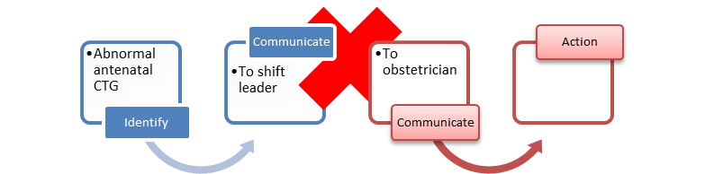
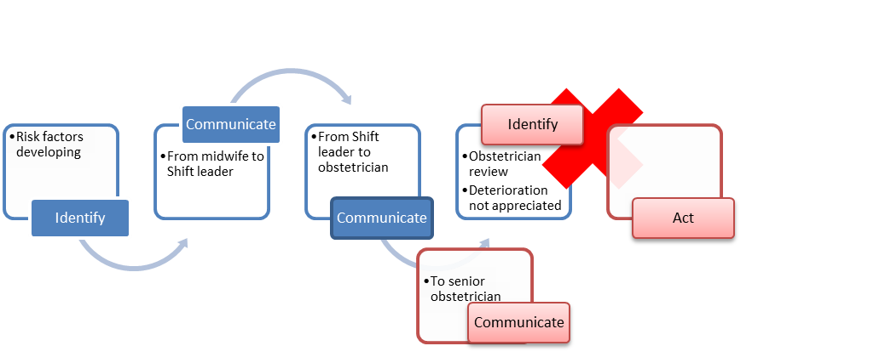
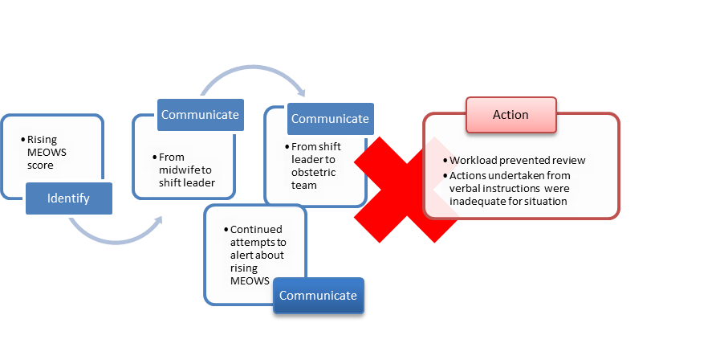
CTG categorised as abnormal during IOL process – escalated to shift leader – advice given to change position and ensure drinking
Abnormal CTG was not escalated to the obstetric team
Throughout the labour there was evidence of good practice where the CTG trace …. Was escalated by the midwifery team to the obstetric team for review when the CTG became difficult to categorise or interpret
Developing risk factors…clinical findings of the review should have been escalated and discussed with a senior member of the obstetric team
Staff …raised concerns and escalated for an obstetric review. The full obstetric team were unavailable to attend…as they were in the operating theatre. Three further escalations were made in relation to the Mother’s rising MEOWS. No bedside review; evidence of verbal discussion and instructions

Slide 8
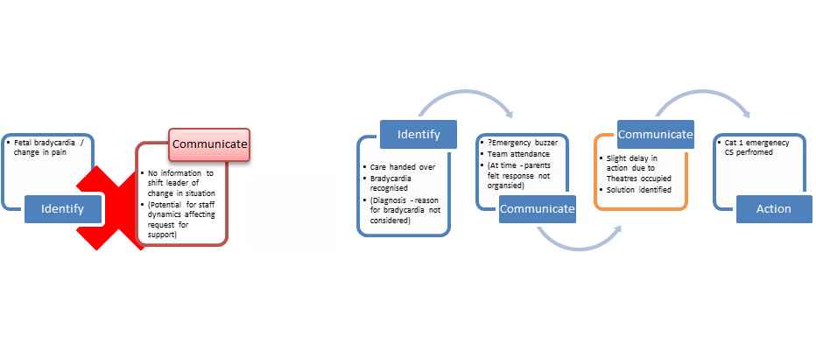
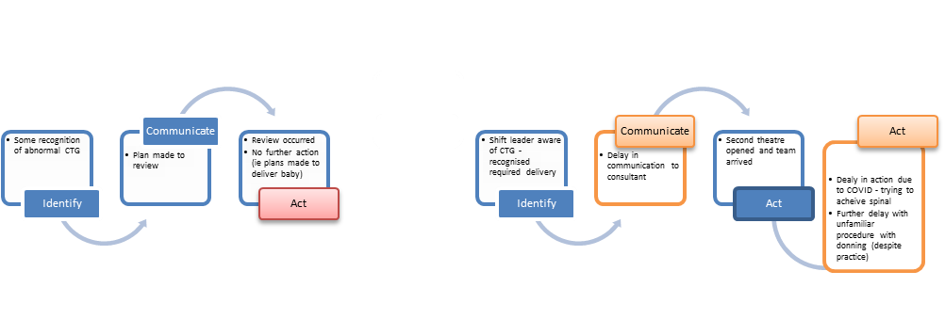
CTG was not recognised to be abnormal. The features of the CTG were attributed to LOC and this became the focus, without consideration of the whole clinical picture.
Reviewed the CTG after 30 minutes of conservative measures as planned however did not then escalate the review
Shift leader did not escalate concerns regarding the deterioration of the CTG to the consultant on call until 22:59 hours despite arranging for a second theatre

Slide 9
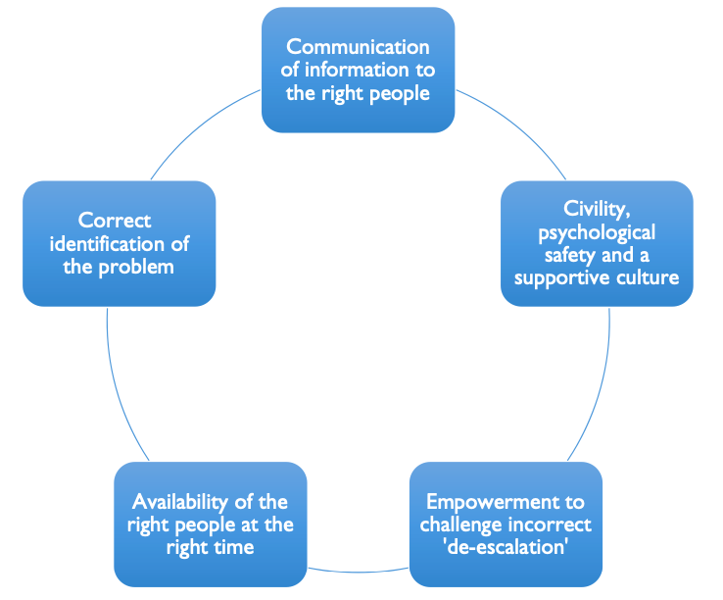
Communication
Identify
Act

Slide 10
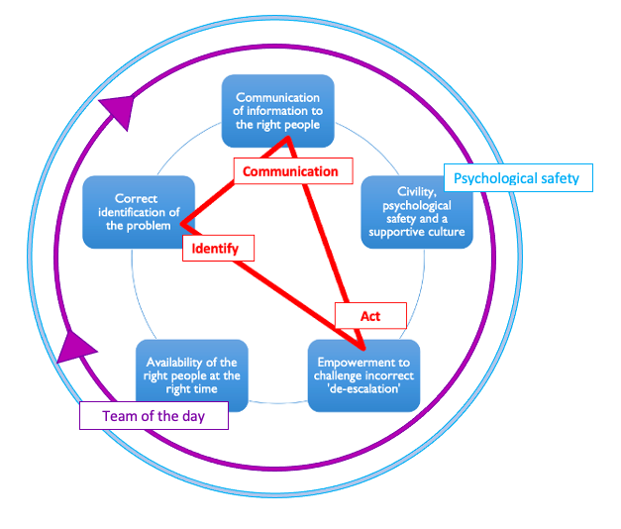

Slide 11

Importance of speaking up for safety
Psychological safety- we should all feel safe/ able to speak our concerns however small
What are the enablers & barriers?
When a concern is raised to you how do you respond?
How can we be supported to speak up in this unit?
Who can you speak up to if do not feel heard?
Does the SBAR handover tool help us?
Is there another tool we can use?

Slide 12
The importance of behaviour
The big challenge facing healthcare and escalation is about how we behave towards one another.
Psychological safety is key to feeling safe and being able to raise concerns
Rudeness and incivility affects us and onlookers. It results in reduced performance, quality of work and cognitive capacity - feeling distracted, reducing commitment and with holding effort

Slide 13
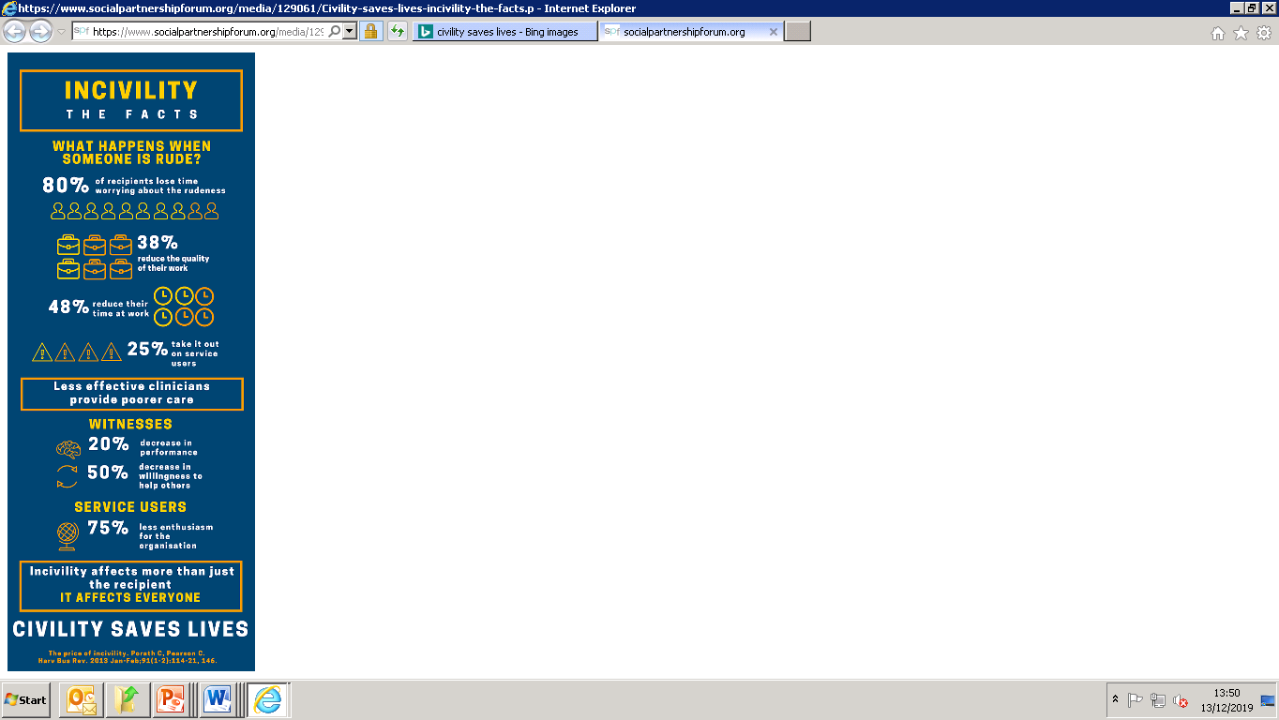





Slide 14
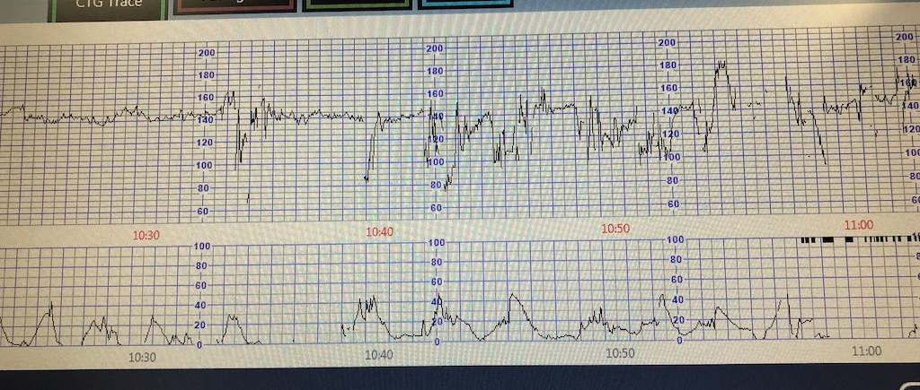
CTG example
Case background: Age 30, post dates IOL at T+12. BMI 33. x1 episode of reduced FM’s @ 39+3. ARM with thin stale meconium, now on oxytocin and epidural. Labour progressing normally. Normal CTG at last fresh eyes 10.00 and 9cm on VE, 10.35, feeling urge to push
In pairs, please ‘fresh eyes’ and classify the following CTG
Notes:
Show a CTG, last baseline 130bpm – and ask staff in pairs to fresh eyes
Classify but not worried about their classification. Instead we will focus and reflect on how you did this/what your conversation looked like

Slide 15

Reflection:
‘fresh eyes’ conversation
What is your reflection on the process and conversation you have just had?
  Did you classify using terminology?
  Did you both agree on the classification?
  How did you reach agreement? What did you both say?
  What would you have done if you did not agree?
  Would that conversation look any different if factors such as distractions, stress (you or others) , if its busy, if you’ve not had a break and are ‘hangry’! If you don’t feel psychologically safe?
  How might that conversation look – escalating and challenging your colleague?

Slide 16
What are the implications on safety?
  We know this area of care is challenging and its not surprising that we do not always agree – it doesn’t just happen with fetal monitoring!
  National and local learning have identified themes and areas for us to focus our energy
  This is about the art of conversation and an environment of psychological safety
  Maintaining an environment of ‘Constructive friction’ – Having a difference of opinion is ok . We disagree and challenge in a respectful way. This is essential for learning and growth, for safety
  This is inherently linked to the 3 step ‘Identify, Communicate, Act’ escalation process – for improving safety
  How can we do this?

Slide 17
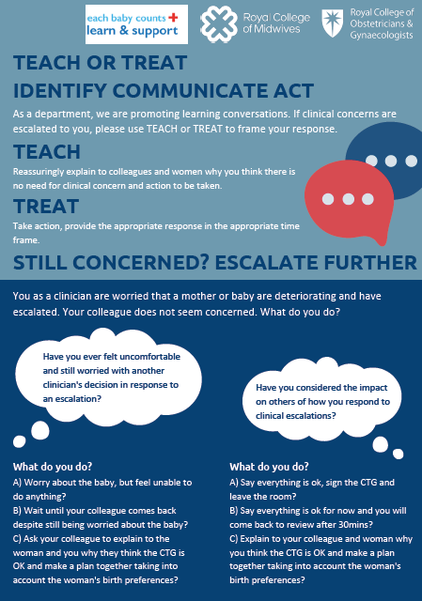

Slide 18
All taking the same approach?
  ‘Teach or Treat’ is a simple practical approach that can be used during escalation conversations
  TEACH
  “This is what I think because ……. and
  What do you think and why………?“
  It feels a safe way to open up conversations, exposes different perceptions and allows education , shared learning and for development of shared mental models.
  TREAT
  “lets treat by doing x ………”
  If you do not agree – escalate ….. seek a 3rd opinion!
Notes:
Having the same approach that opens up the opportunity for shared learning is fundamental to improving safety. It is important that work in an environment where safe healthy challenge in the norm, where we all feel psychologically safe and that we work towards developing shared mental models.
This approach may support effective decision-making care planning, promote shared learning and escalation of concerns

Slide 19
How does this translate into reality?
Review the full clinical picture and any risk factors - using knowledge and tools (CTG, MEOWs, NEWTS)
  We can ask the question
  “How are mum and baby(s)?”
Do fresh eyes/ears independently, compare and discuss together
  “This is what I think because…….
  Tell me what you think and why”….
  This is the basis of a ‘Teach or Treat’ approach
Notes:
Fresh eyes is a safety intervention designed to keep us all safe – double checking …. We do it with drugs/CD’s and in so many other areas of our lives so we avoid/reduce potential for mistakes

Slide 20
Reflections –
Escalation language and documentation
Escalation language?
Do you feel confident to escalate?
Do you consistently use agreed terminology and tools to communicate in escalation situations?
    “I am concerned. I have classified the CTG as …..
    Could you please review ….. in X time frame.
    The SBAR is ………”
Documentation of escalations?
How do you document escalations?
“X asked to review/review CTG”
vs
    “Escalated to ……. re concern ……..
    Requested review in X time frame ………Response was ………..”

Slide 21
Framing Escalation
Do you always know when you’re escalating?
Do you know what response you need?
Do you know when you’re being escalated to?
Do you always know what response is needed?

Slide 22
Improving Escalation
We can improve clinical escalation using safety critical language:

Slide 23
Using AID
AID is as a clear and simple communication tool which initiates escalation conversations using 3 simple phrases:
“I am asking you for Advice”,
“I am Informing you” and
“I need you to Do…”
It is designed to precede SBAR (situation, background, assessment, recommendation)

Slide 24
Using AID (2)
It can also be used “in reverse” – ie if it is unclear what response the person escalating is looking for, the clinician being escalated to can ask the following:
“Are you asking me for Advice”,
“Are you Informing me”,
“Do you need me to DO something / what would you like me to DO”?
It is not expected that you force these exact phrases into conversations, but that the principles of “ADVICE, INFORM, DO” are used as a framework when escalating.

Slide 25
Why, When?
Clearly identify when escalation is taking place
Elicit a time critical response, reducing delays
Help prioritisation for clinicians who may receive multiple escalations within any given shift (band 7 midwifery co-ordinators, consultants)
Empower junior staff
Used…..
At the outset of all escalation conversations between ALL members of the MDT
Particularly helpful when escalating to non resident clinicians (usually consultants) and during periods of high activity

Slide 26
Session recap, What now?
What have you learnt?
You know where we are we now and have started to think about how can continue to improve
Fresh eyes process – reflecting on this and how you do things (case exercise)
Introduced ‘Teach or Treat’ approach – for consistency and to educate for shared learning
Introduced ‘AID’ – framing escalation conversations with safety critical language
What will you take away from this session?
What will you do now to make change happen?........

Slide 27
Thank you

